Slide 1
Using ColdFusion ORM
Nick Kwiatkowski
Hawaii ColdFusion User’s Group
4/29/22

Slide 2
Agenda
What is an ORM system?
Pieces and Parts to using ORM in CFML
Basic CRUD operations
Building Relationships
HQL, grouping and computed rows
Optimizations, debugging and gotchas

Slide 3
Welcome!
Slides, examples and docker images can be found at :
https://github.com/quetwo/orm-preso
Take a look at the README for instructions on getting started. You have a few minutes while we talk about the basics.
This presentation assumes you have a passing knowledge of CFCs and basic CFML. We will be using the Lucee engine and MySQL for our demos, but Adobe CF (version 9.1 and later) and other SQL engines will be nearly identical.
This meeting will be recorded.

Slide 4
About Nick
CF programmer since the mid 90’s – started with CF 4.0.1
Member of the Apache Foundation, and a committer to a few projects
MMCFUG member and contributor
Adjunct Professor at Michigan State University in the College of Communication Arts and Sciences
Manager of the Unified Communications Team at Michigan State University

Slide 5
What is ORM

Slide 6
What is an ORM?
An ORM = Object Relation Manager
A system that manages the database layer within code.
Classes (or components in CF’s case) are directly translated to the database by an ORM. A database will have a table that represents a class in code. A row in the database represents an instance of the class.
1,000ft view – this means that each instance of this class is persisted not only in memory, but in a database. Data from the DB is also cached!
A quick benefit – you no longer need to write SQL. The ORM writes the SQL for you.
You no longer have to worry about SQL dialects – making your code much more portable across servers and platforms.

Slide 7
What is an ORM?
ORM technologies built on Java Hibernate have been built in to the CFML language since 2010.
Adobe ColdFusion 9 (really 9.0.2)
All versions of Lucee & Railo
No external frameworks or dependencies required to use.
There are 3rd party ORM systems available in CF as well.
ColdBox ORM
Mura / Masa CMS ORM

Slide 8
Basics of Scaffolding & Setup

Slide 9
Basics of Scaffolding
Scaffolding == Creating your DB layout via code.
You start with your CF Components and have CF create the database to match it.
All properties, indexing, etc. are all done for you. You won’t care about the back-end DB type
Setting up the CF ORM is done in the application.cfc
ormenabled property on the application.
ormsettings property for additional settings.
datasource property to define which datasource in CF/Lucee

Slide 10
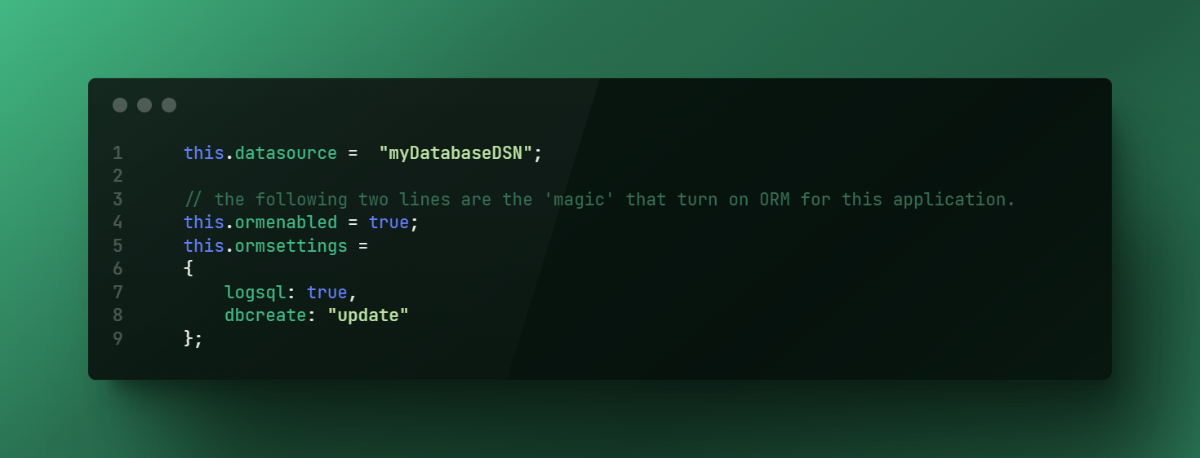
Basics of Scaffolding

Slide 11
Setup the Components
Once ORM is enabled in your application, you need to define some CFCs to take advantage of it.
New property on the CFC to tell the ORM engine that you want to ‘persist’ the component in the database.
Need to define the properties and give metadata as to what you plan on storing in them. These create automatic getter/setter functions for you.
Once you have these done, everything is wired up for you to write data to the database!

Slide 12
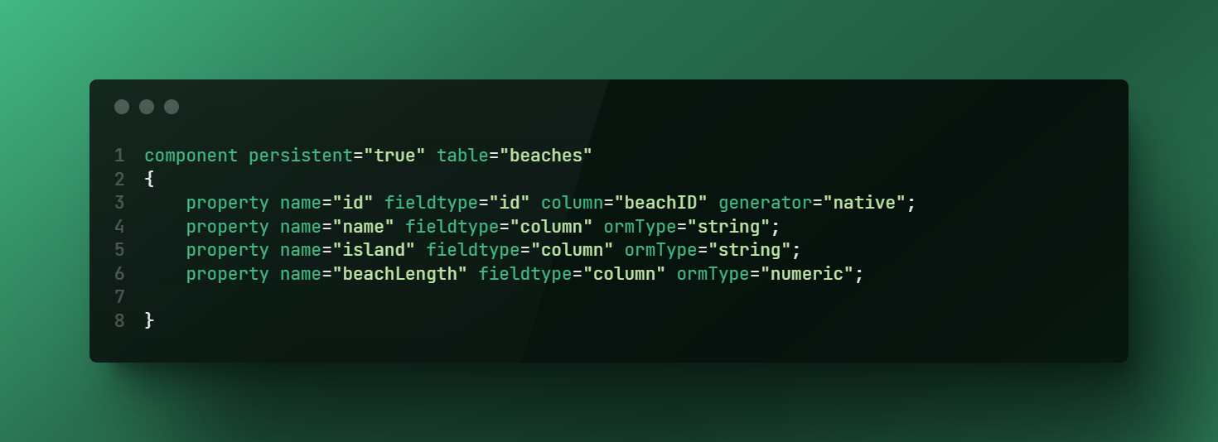
Setup the Components

Slide 13
Setup the Components
Your key field for the DB.
Field type of ‘id’. You will need to specify the ‘generator’
Most DBs you can use ‘native’. This will tell hibernate to pick the best way to setup a key field, based on the DB type.
Other generators also exist, including ones that will auto-increment, increment manually (usefully if you have other apps touching the data), create UUIDs, etc.
Regular Columns
Field type of ‘column’. Set the field-type as ‘column’ and set a ormType
ORMType can be ‘string’, ‘numeric’, ‘date’, ‘timestamp’, etc.
You can set other restrictions on the fields as well.

Slide 14
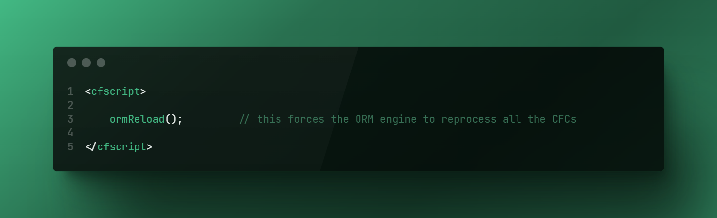
Setup the Components
Because CF caches the persistent component definitions when the application is initialized, you have two options to have your CFML engine see the changes:
Restart the CF Engine
Execute the ormReload() function.
The ormReload() function causes the Hibernate to be restarted, cache cleared and CFCs are reloaded. DB changes should be realized at this point.
Keep in mind, ormReload will clear out any unsaved data!

Slide 15
Demo 1
Setting up an ORM application

Slide 16
CRUD
Create, Read, Update, Delete

Slide 17
CRUD
Now we’ve determined that the table has been setup, let’s add a new entry into the table.
Remember, no SQL needed. Everything is done by touching the properties of the component.
entityNew = creates a new instance of the cfc in memory.
entitySave = tells the ORM to commit that data to the DB. If you don’t do this, it won’t get created.
Entities don’t get written to disk right away – they may be cached in memory for a while first! Issue an ormFlush() to save everything to disk right then.

Slide 18
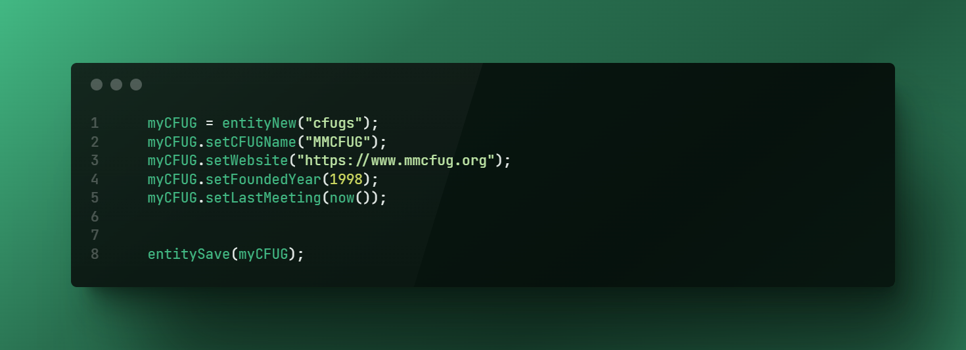
CRUD - Create

Slide 19
CRUD - Read
To get items out of the database, you will need to use one of the EntityLoad functions :
entityLoad(“componentName”); // returns an array of components
entityLoadByPK(“componentName”,id); // returns a single component
entityLoad(“componentName”, {filter}, unique); // returns an array, unless unique is set to true.
Unlike a <cfquery> command, you will get an Array back, not a query.
You can convert an array into a query if you need using the entityToQuery(entity) function.

Slide 20
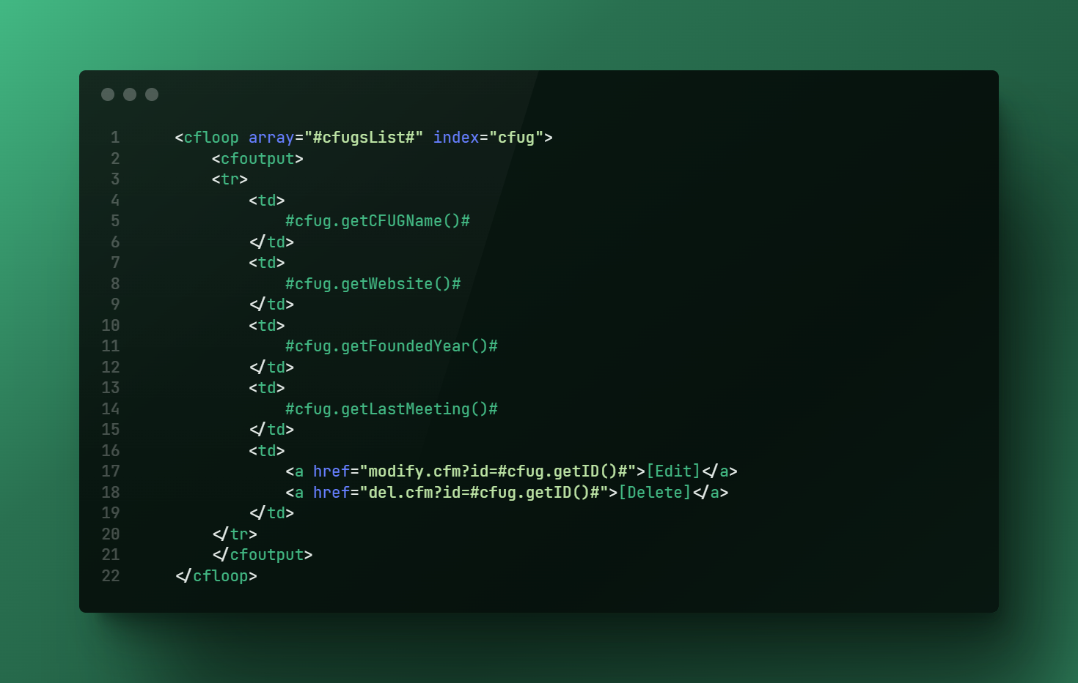
CRUD - Read

Slide 21
CRUD - Read
You can also filter (where clause) using the entityLoad() function.

Slide 22

CRUD - Update

Slide 23
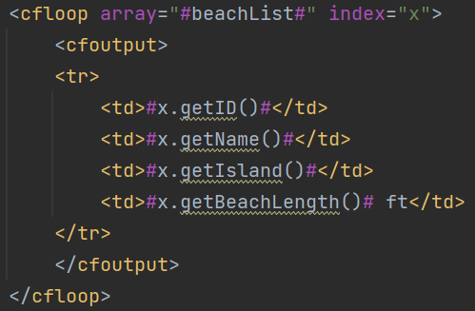
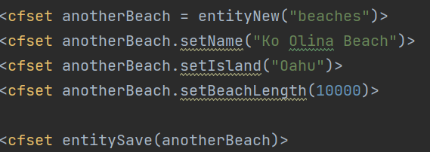
CRUD
By default, every property that you create in the component has a getter and setter wired up by the ORM.
component.setValue(“abc”);
myValue = component.getValue();

Slide 24
CRUD
Retrieving Data :
entityLoad(“componentName”); // returns an array of components
entityLoadByPK(“componentName”,id); // returns a single component
entityLoad(“componentName”, {filter}, unique); // returns an array, unless unique is set to true.
You would then display the data as any other array. CFLOOP, etc.

